Slide 1

Recommendation System using PySpark
Peeyush Dyavarashetty

Slide 3

Understanding the Problem
Prediction version:
Complete $M×N$ matrix for $M$ users and $N$ movies
Ranking version:
Provide top-k items for user
Methods:
Content-based filtering
User past history
Collaborative filtering
User-user comparison
Movie-movie comparison
Latent factor methods
 | 1 | 2 | 3 | 4 | 5
1
2
3
4
5

Slide 4

Understanding the Problem
Prediction version:
Complete $M×N$ matrix for $M$ users and $N$ movies
Ranking version:
Provide top-k items for user
Methods:
Content-based filtering
User past history
Collaborative filtering
User-user comparison
Movie-movie comparison
Latent factor methods
 | 1 | 2 | 3 | 4 | 5
1
2
3
4
5

Slide 5
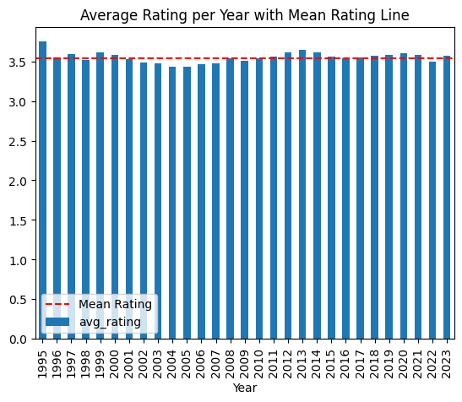
Data Split – Time based or Random?
Average rating per year
Mean: 3.55
Median: 3.548
Standard deviation: 0.067
Min rating: 3.43
Max rating: 3.75
Independent of time
Random split is fine

Slide 6
Data Split – Time based or Random?
Average rating per year
Mean: 3.55
Median: 3.548
Standard deviation: 0.067
Min rating: 3.43
Max rating: 3.75
Independent of time
Random split is fine

Slide 7
Data Split – Time based or Random?
Average rating per year
Mean: 3.55
Median: 3.548
Standard deviation: 0.067
Min rating: 3.43
Max rating: 3.75
Independent of time
Random split is fine

Slide 8

Understanding the Problem
Prediction version:
$M$ users and $N$ movies
Complete $M×N$ matrix for
Ranking version:
Provide top-k items for user
Methods:
Content-based filtering
User past history
Collaborative filtering
User-user comparison
Movie-movie comparison
Latent factor methods
User\Item | 1 | 2 | 3 | 4 | 5
1 |  |  |  | 4.0 | 1.0
2
3 | 3.5 | 4.0 | 4.0 | 5.0
4
5 |  | 4.0

Slide 9
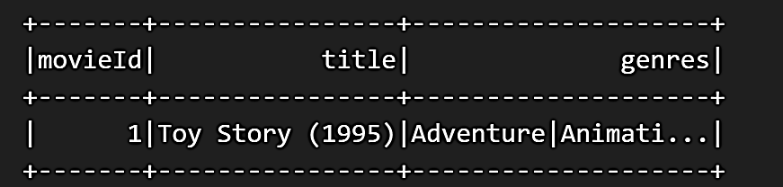
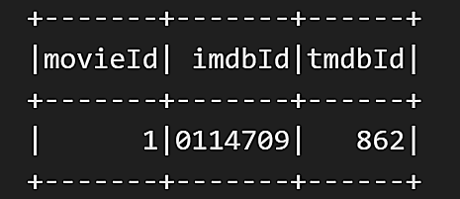
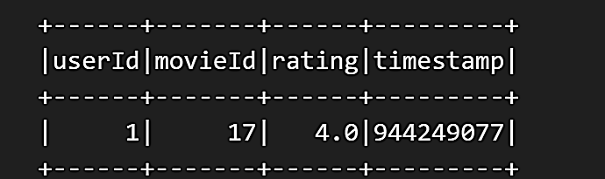
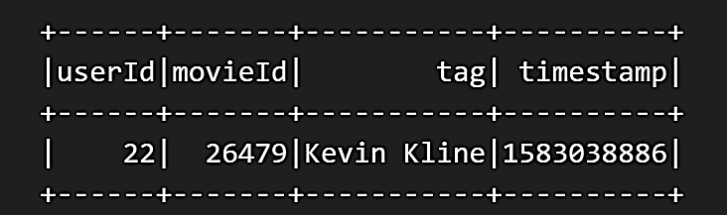
Data
Movies
Links
Ratings
Tags

Slide 10
Data Split – Time based or Random?
Average rating per year
Mean: 3.55
Median: 3.548
Standard deviation: 0.067
Min rating: 3.43
Max rating: 3.75
Independent of time
Random split is fine

Slide 11
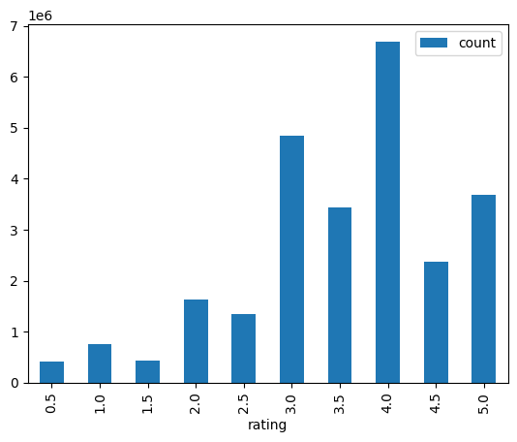
Training data Statistics
Train split: 80%
Number of users: 200948
Number of movies: 80185
Matrix sparsity: 0.159%
Average ratings
Per user: 127.4
Per movie: 319.27
Ratings are skewed
Tending towards 4

Slide 12
Training data Statistics
Train split: 80%
Number of users: 200948
Number of movies: 80185
Matrix sparsity: 0.159%
Average ratings
Per user: 127.4
Per movie: 319.27
Ratings are skewed
Tending towards 4

Slide 13

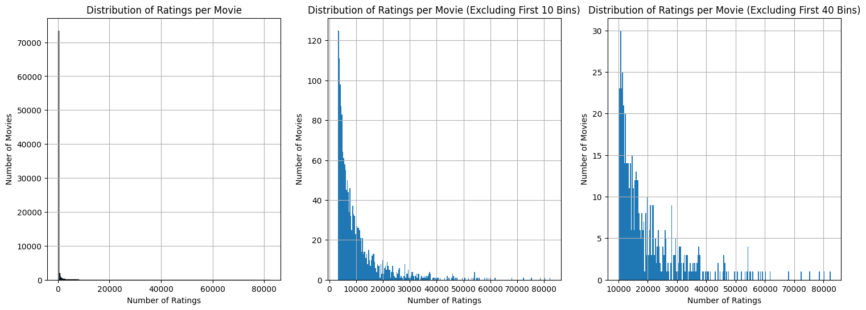
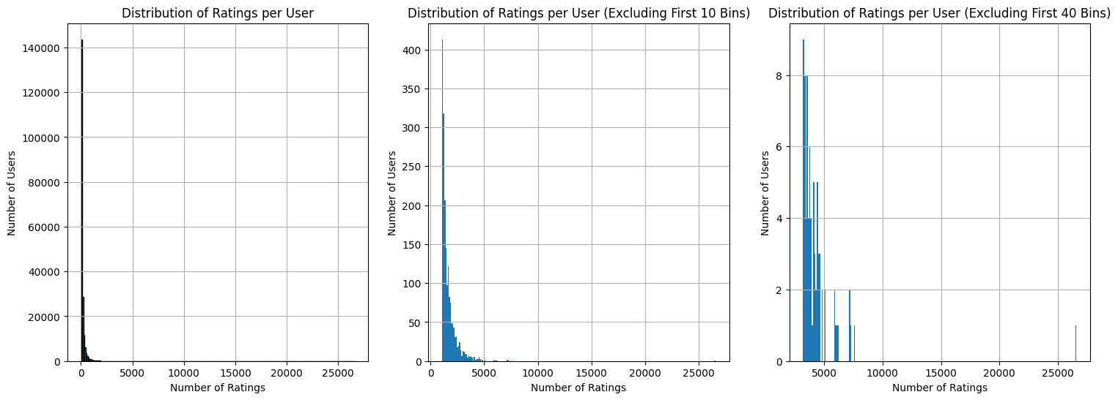
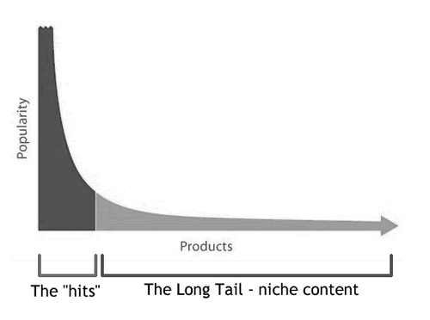
Users and Movies Distribution
Long Tail
Few users rated many movies
Few movies are rated by many users
https://neptune.ai/blog/recommender-systems-metrics

Slide 14
Users and Movies Distribution
Long Tail
Few users rated many movies
Few movies are rated by many users
https://neptune.ai/blog/recommender-systems-metrics

Slide 15
Metrics
Prediction:
RMSE
MAE
Weighted MAE
Weighted RMSE

Slide 16
Baselines
Average rating
Median rating
Metric | Rating
RMSE | 0.963
MAE | 0.742
Weighted RMSE | 0.967
Weighted MAE | 0.746
Metric | Rating
RMSE | 0.985
MAE | 0.722
Weighted RMSE | 0.988
Weighted MAE | 0.726

Slide 17
Baselines
Metric | Average | Median
RMSE | 0.963 | 0.985
MAE | 0.742 | 0.722
Weighted RMSE | 0.967 | 0.988
Weighted MAE | 0.746 | 0.726
Simple group by based on Movie
Took average and median
Excellent performance

Slide 18

KNN
200k users and 84k movies
Time complexity for all users:
O(N^2 x M) = O(3.36 x 10^15) = 11.5 days
O(M^2 x N) = O(1.41 x 10^11) = 1.68 min
O(M^2) memory
Impossible for all users in single run
Dimensional reduction:
Not possible
Unbearable for even 84k movies

Slide 19
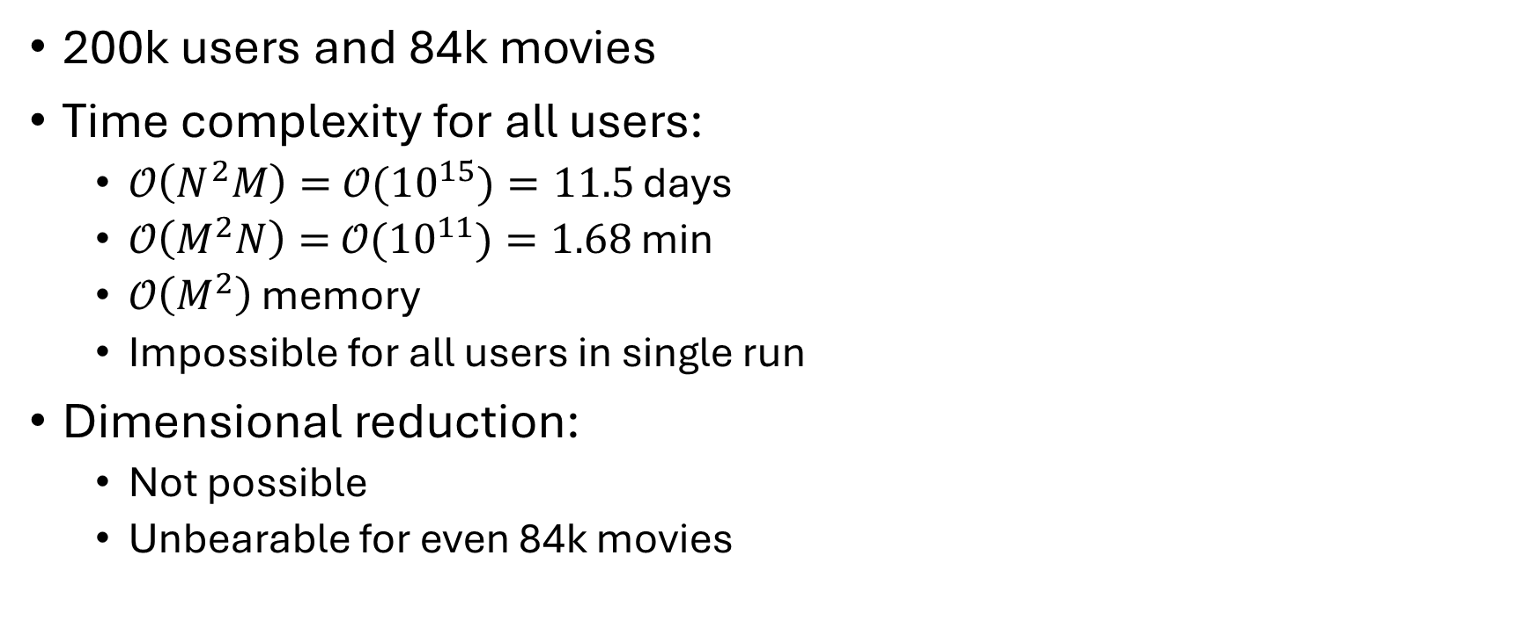
K-Nearest Neighbors
200k users and 84k movies
Time complexity for all users:
𝒪$\left(N^{2}M\right)=$𝒪${(10}^{15})=11.5$ days
𝒪$\left(M^{2}N\right)=$𝒪${(10}^{11})=1.68$ min
𝒪$\left(M^{2}\right)$ memory
Impossible for all users in single run
Dimensional reduction:
Not possible
Unbearable for even 84k movies

Slide 20
KNN Dimensional Reduction
K-D trees
Low dimensional and real-valued
O(M log2N), when M << N
Can miss neighbours
Inverted lists
High dimensional, sparse data
O(N’M’), where N’ << N, M’ << M
Exact
Locality-sensitive hashing
High-d, real-valued or discrete
O(N’M), N’ << N
Bits in fingerprint
Can miss neighbours

Slide 21
K-NN Dimensional Reduction
k-D trees
Low dimensional and real-valued
Inverted lists
High dimensional, sparse data
LSH
High-d, real-valued or discrete
𝒪$(M\log_{2}{N})$, when $M≪N$
𝒪(𝑀 log_2⁡𝑁), when 𝑀≪𝑁
Can miss neighbours
𝒪$(N^{′}M^{′})$, $N^{′}≪N, M^{′}≪M$
𝒪(𝑁^′ 𝑀^′), 𝑁^′≪𝑁, 𝑀^′≪𝑀
Exact
Can miss neighbours
𝒪$\left(N^{′}M\right), N^{′}≪N$
𝒪(𝑁^′ 𝑀), 𝑁^′≪𝑁
Bits in fingerprint

Slide 22
K-NN Dimensional Reduction
k-D trees
Low dimensional and real-valued
Inverted lists
High dimensional, sparse data
LSH
High-d, real-valued or discrete
𝒪$(M\log_{2}{N})$, when $M≪N$
𝒪(𝑀 log_2⁡𝑁), when 𝑀≪𝑁
Can miss neighbours
𝒪$(N^{′}M^{′})$, $N^{′}≪N, M^{′}≪M$
𝒪(𝑁^′ 𝑀^′), 𝑁^′≪𝑁, 𝑀^′≪𝑀
Exact
Can miss neighbours
𝒪$\left(N^{′}M\right), N^{′}≪N$
𝒪(𝑁^′ 𝑀), 𝑁^′≪𝑁
Bits in fingerprint

Slide 23
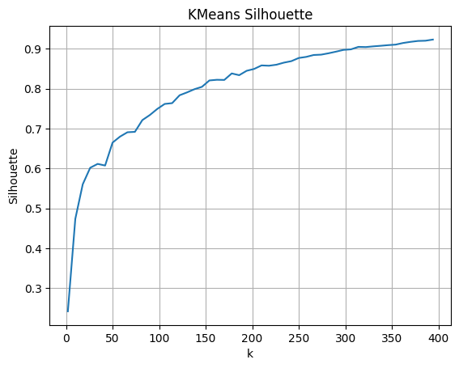
K-means heuristic
Divided movies based on genre
Separated them using k-means
Took average, median and top k movies
Poor performance – Need more tests
Method | RMSE | MAE | W. RMSE | W. MAE
Mean | 1.792 | 1.222 | 1.738 | 1.182
Median | 1.807 | 1.216 | 1.754 | 1.176
Top-10 avg | 1.854 | 1.298 | 1.815 | 1.276

Slide 24
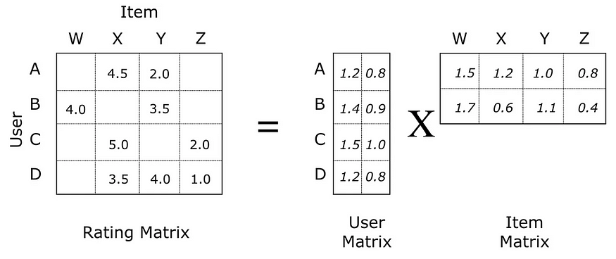

Alternating Least Square method
Latent factor method
Divides $M×N$ matrix into 2 small matrices.

Slide 25
Alternating Least Square method
Latent factor method

Slide 26
Problems with Ranking
Very low values even at k=100
Needle at haystack
 | K=10 | K=100
Precision | 5e-7 | 1.55e-6
Recall | 6.25e-7 | 2.75e-6
NDCG | 4.5e-7

Slide 27
Future Work
Complete k-NN using Inverted lists
Test more on k-means heuristic
Mix k-NN with k-means
Test more param grid in ALS
Convex Optimization formulation
Concentrate on Ranking version

